Slide 1

Group Monitoring Sheet (Batch no. S3; Group – A5) Topic: - Online Auction System
A
PBL PROJECT REPORT ON
Online Auction System
Submitted in partial fulfillment for Degree Of
SECOND YEAR
Of
BACHELOR OF ENGINEERING (COMPUTER)
Submitted By
STUDENT’S NAME |  | ROLL NUMBER
1) | ANIKET CHIKANE | 2122
2) | ABHISHEKH DHANAPUNE | 2130
3) | DANGE RAHUL
4) | SUJIT DARKUNDE
5) | PRAJWAL BANKAR
6) | SAMADHAN DESHMUKH
Under the Guidance of PROF. J.N GANTHADE Madam
SE COMPUTER 2021

Slide 2
Group Monitoring Sheet (Batch no. S3; Group – A5)
Topic: - Online Auction System
ACKNOWLEDGEMENT
I take this opportunity to acknowledge a deep sense of gratitude to our guide Prof. J.N Ganthade Madam for his valuable guidance and useful suggestions, which helped us in completing this Project on time.
Finally, we thankful to all those who extended their help directly or indirectly for the successful completion of this project.

Slide 3
Group Monitoring Sheet
(Batch no. S2; Group – A5)
Topic: - Online Auction System
Group Name: Online Auction System
Week 1: - In First Week firstly we all group members are interact with each other. also, we discussed about PBL project and also, we start to find the effective project for preparation.
Date: - 9 April 2021 and 10 April 2021
Current Work phase of project-: In first week, we collect various data about the project. Also, we start to find the effective project for preparation. whenever we are doing some tasks as a computer Engineer, we think and imagine about it. And after We implement it. So similarly, we started to think about outline map for us project and start thinking about it
Discussions Held: - In this discussion We all distribute our task itself for finding the topic for implementation. Also, in this session we decide our group leader.
Progress till Date: - After Next PBL Session All Give their Task Status to Group Leader.
Sign of Mentor

Slide 4
Group Monitoring Sheet
(Batch no. S2; Group – A5)
Topic: - Online Auction System
Group Name:Online Auction System
Week 2: - These is second week in this week We Finalize our topic and send the group name and topic name to Our Prof.
Date: - 15 April 2021 and 16 April 2021
Current Work phase of project- Now All Should done their task frequently. so now we are able to finalize our topic. In first session we all share our views on selecting the topic so finally we conclude and select out topic and the topic was “Online Auction System” Then we submit our topic towards Mam and start the thinking about project.
Discussions Held: - We select this topic to make buy and sell process easier To make our life easier.
Progress till Date: - Now our topic is ready and we looking forward to implement it. Also, at time we decided to distribute the task to everyone and now I (Leader) take some time to give task to everyone.
Sign of Mentor

Slide 5
Group Monitoring Sheet
(Batch no. S2; Group – A5)
Topic: - Online Auction System
Group Name: Online Auction System
Week 3: - These is the 3rd week and now we start for implementation.
Date: - 22 April 2021
Current Work phase of project: - we are with our topic. now again we give the task to everyone. In this week our aim is to prepare the project and also discuss project with all members.
Discussions Held: - We discuss our project progress with each member of group and group leader ask them about their given task and any difficulties for group members. We discussed about our project part availabilities.
Progress till Date: - Now we start programming of our project.
Sign of Mentor

Slide 6
Group Monitoring Sheet
(Batch no. S2; Group – A5)
Topic: - Online Auction System
Group Name: Online Auction System
Week 4: - These is week no. 4 and we are complaining our assembling software and hardware part.
Date: - 28 April 2021 And 29 April 2021
Current Work phase of project: - We are near to complete our project up to 29 April 2021 and other works.
Discussions Held: - We complete our Software part and hardware requirments
Progress till Date: Project is completed but some changes are remaining
Sign of Mentor

Slide 7
Group Monitoring Sheet
(Batch no. S2; Group – A5)
Topic: - Online Auction System
Group Name: Online Auction System
Week 5: - These is week no. 5 and maybe it is last week for implementation. We also get more time in this period because of our SPPU Exam was End.
Date: - 12 May 2021 And 13 may 2021
Current Work phase of project: - We are near to complete our project, last some project checking work is done, also, testing is done.
Discussions Held: - In this week we discuss about checking and testing our project and how to implement it.
Progress till Date: - Now we are at the end of project. because presentation is start. and we also done the monitoring sheet.
Sign of Mentor

Slide 8
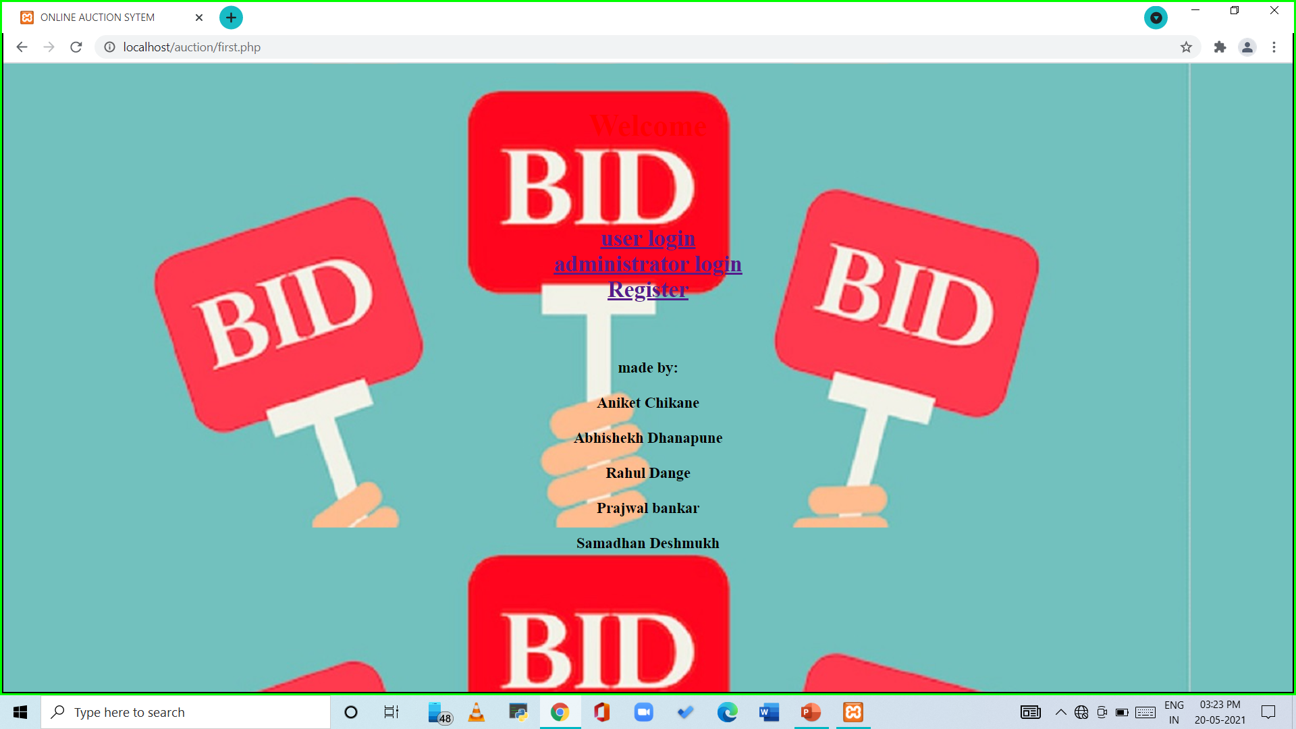
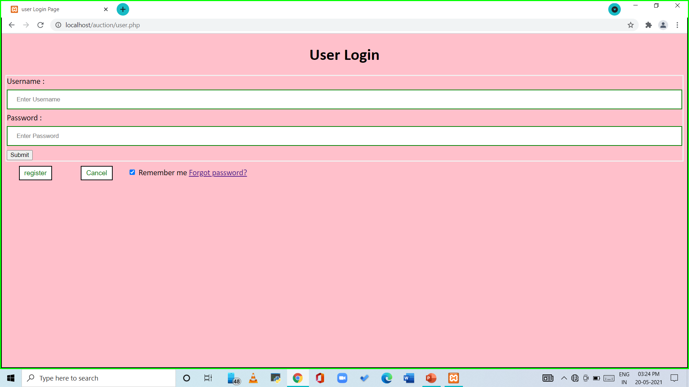

Slide 9
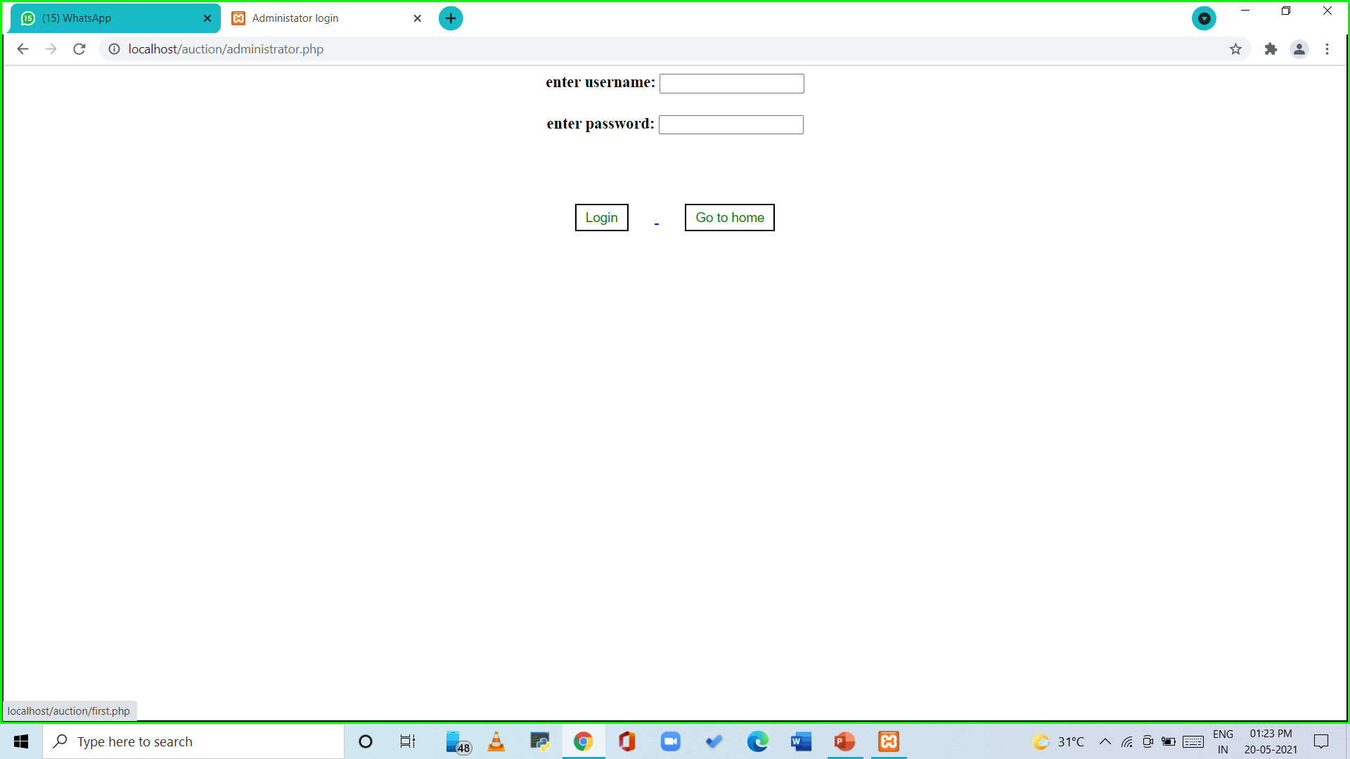
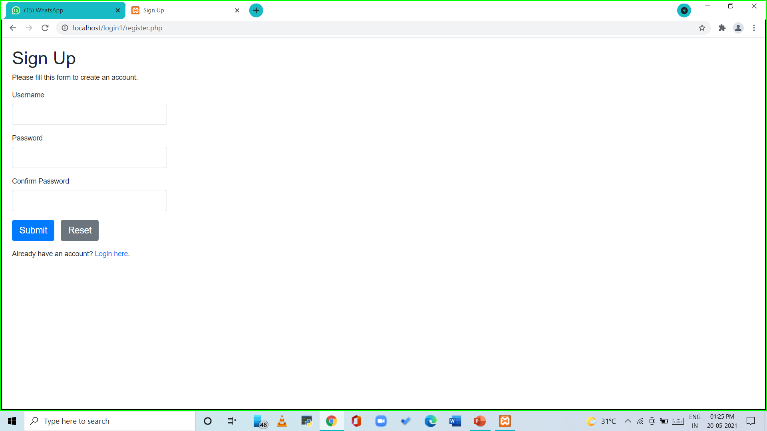

Slide 10
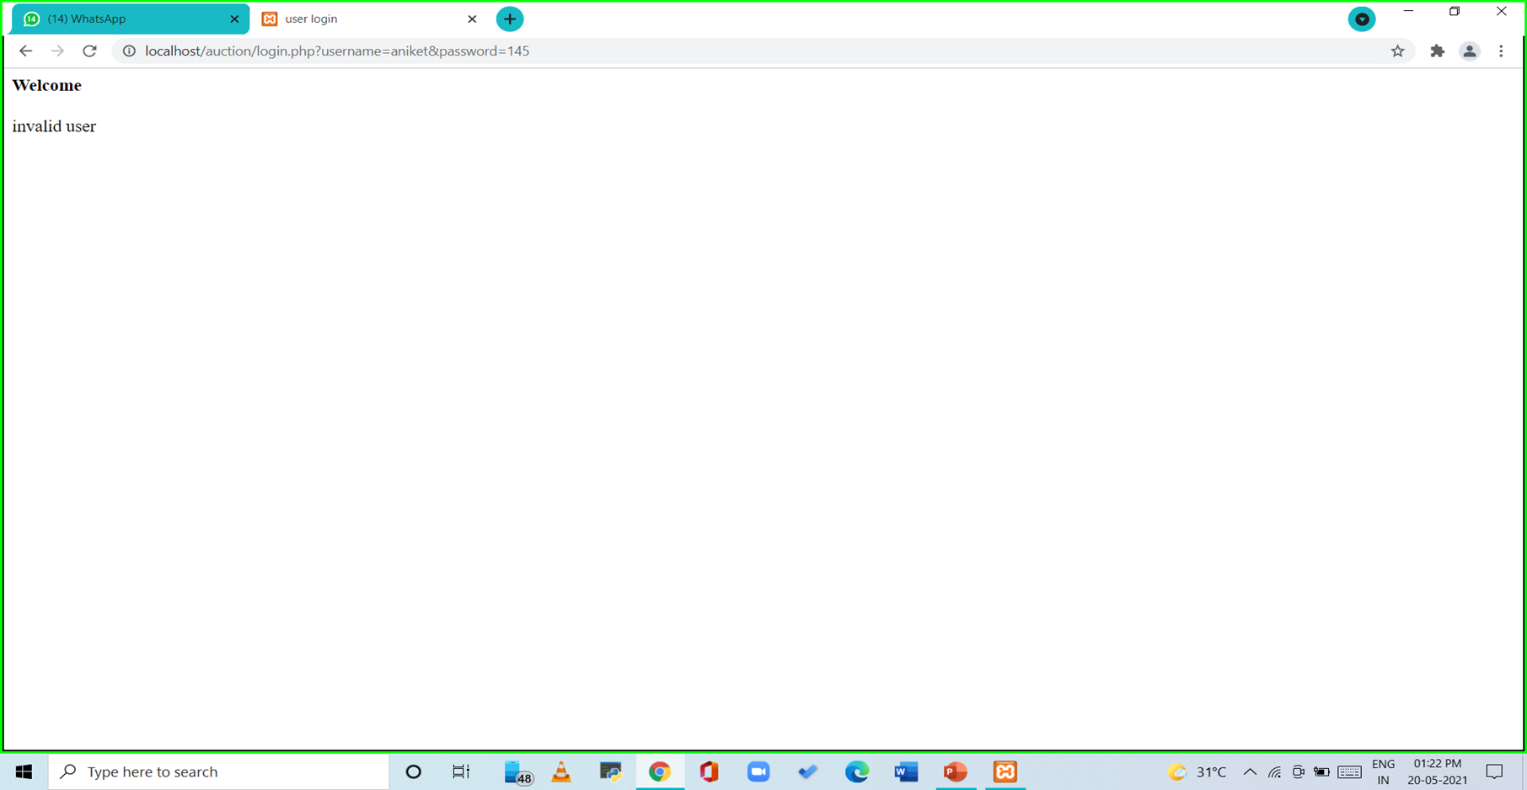
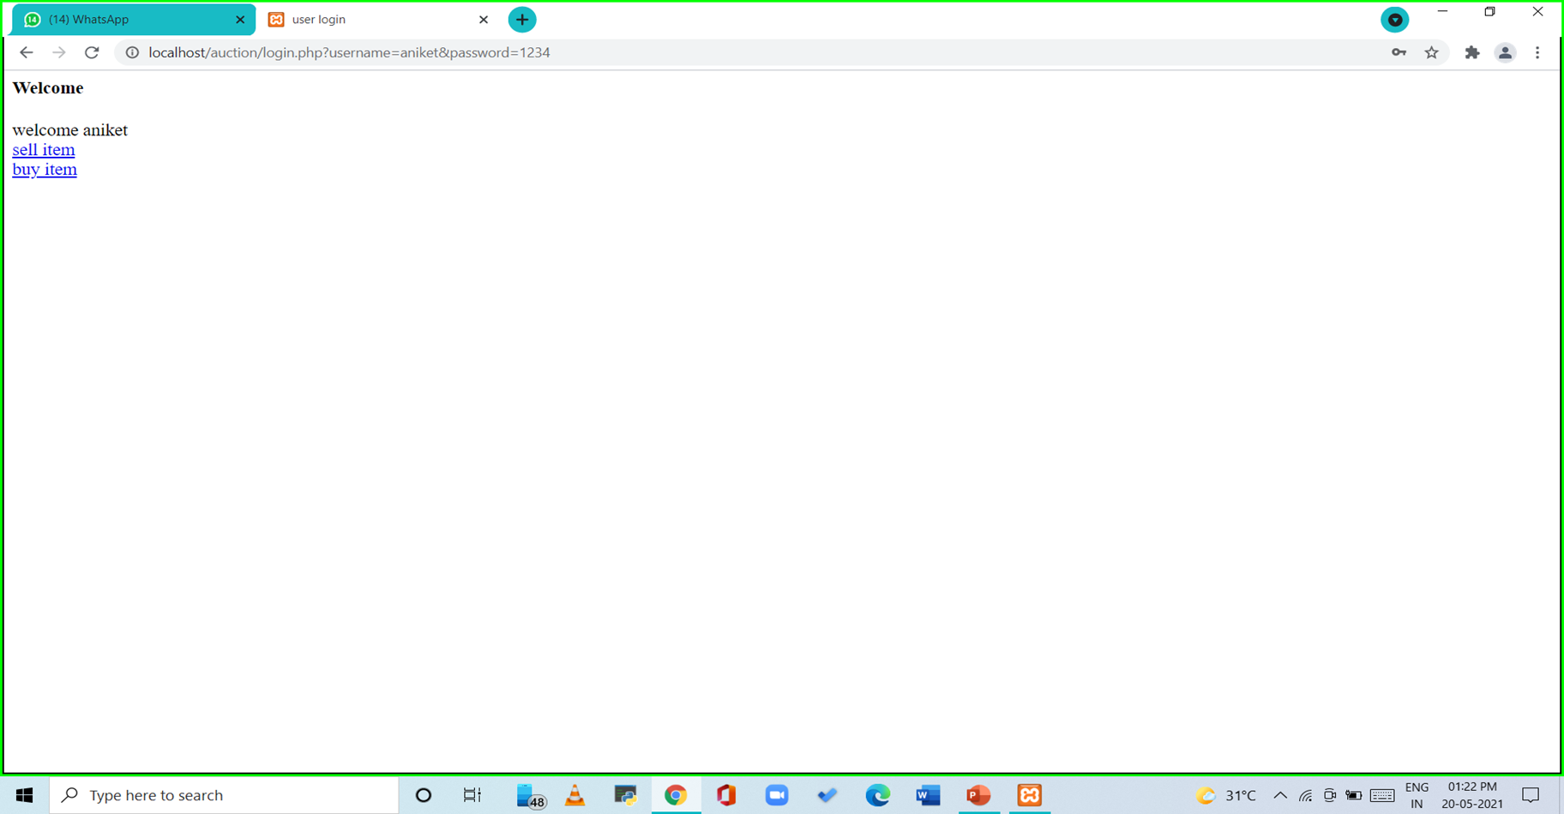

Slide 11
